Slide 1
Theory of Automata Pumping lemma for CFL
Dr. Sabina Akhtar

Slide 2
Revision

Slide 3
Intuition
Recall the pumping lemma for regular languages.
It told us that if there was a string long enough to cause a cycle in the DFA for the language, then we could “pump” the cycle and discover an infinite sequence of strings that had to be in the language.

Slide 4
Intuition – (2)
For CFL’s the situation is a little more complicated.
We can always find two pieces of any sufficiently long string to “pump” in tandem.
That is: if we repeat each of the two pieces the same number of times, we get another string in the language.

Slide 5
Statement of the CFL Pumping Lemma
For every context-free language L
There is an integer n, such that
For every string z in L of length > n
There exists z = uvwxy such that:
|vwx| < n.
|vx| > 0.
For all i > 0, uv^{i}wx^{i}y is in L.

Slide 6
Pump Zero Times
A
A
A
w
u
v
x
y
u
y
w

Slide 7
Pump Twice
A
A
A
A
A
u
v
x
y
u
v
x
y
w
v
w
x

Slide 8
Pump Thrice
A
A
A
A
A
u
v
x
y
u
v
x
y
w
A
v
x
v
w
x

Slide 9
Using the Pumping Lemma
Non-CFL’s typically involve trying to match two pairs of counts or match two strings.
Example: The text uses the pumping lemma to show that {ww | w in (0+1)*} is not a CFL.

Slide 10
Using the Pumping Lemma – (2)
{0^{i}10^{i} | i > 1} is a CFL.
We can match one pair of strings.
But L = {0^{i}10^{i}10^{i} | i > 1} is not.
We can’t match two pairs, or three strings as a group.
Proof using the pumping lemma.
Suppose L were a CFL.
Let n be L’s pumping-lemma constant.

Slide 11
Using the Pumping Lemma – (3)
Consider z = 0^{n}10^{n}10^{n}.
We can write z = uvwxy, where |vwx| < n, and |vx| > 1.
Case 1: vx has no 0’s.
u=0^{n}, vwx=1, y=0^{n}10^{n}
v=1, w= e, x=e
If we pump down i=0
uv^{i}wx^{i}y = 0^{n} 0^{n}10^{n} does not belong to language.

Slide 12
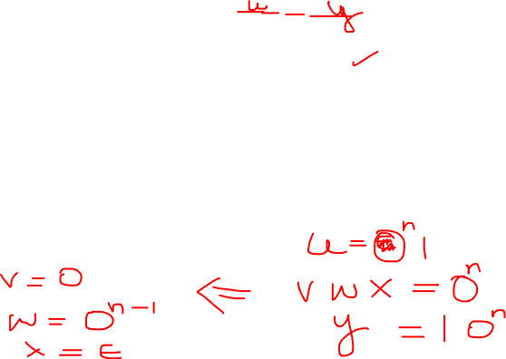
Using the Pumping Lemma – (4)
Still considering z = 0^{n}10^{n}10^{n}.
Case 2: vx has at least one 0.
vwx is too short (length < n) to extend to all three blocks of 0’s in 0^{n}10^{n}10^{n}.
Thus, uwy has at least one block of n 0’s, and at least one block with fewer than n 0’s.
Thus, uwy is not in L.

Slide 13
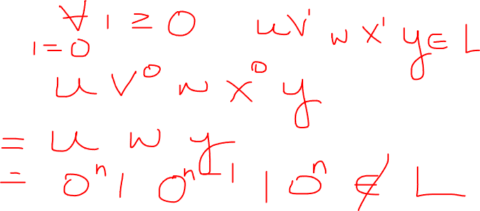

Slide 14
Class Activity
L = {0^{i}1^{i}2^{i} | i > 1}

Slide 15
References
Book Chapter 7
Lectures from Stanford University
http://infolab.stanford.edu/~ullman/ialc/spr10/spr10.html#LECTURE%20NOTES

